Slide 1
The Most Basic Genetic Algorithm
Bob French
CNRS, Dijon, France

Slide 2
The most basic genetic algorithm
T is the task to be done.
Create a population of N random bit strings. This is the First Pool.
B1
B2
B3
B4
B5
B6
B7
B8
B9
B10
0 1 0 0 1 1 0 0 0 0
1 0 1 0 0 1 0 1 0 0
1 0 1 1 0 0 1 0 1 0
0 0 0 1 0 0 1 0 1 0
0 1 1 0 1 0 0 0 0 0
1 0 0 1 1 0 0 0 1 1
1 0 0 0 1 1 0 1 1 1
0 0 1 1 1 1 1 0 0 1
0 1 1 0 1 0 0 0 1 0
1 1 0 1 0 1 1 1 0 0
…
Each bit string represents an “individual” in the population

Slide 3
Each individual, B_{i}, is more or less “fit” with respect to the task T.
For each B_{i} calculate its fitness, F_{i}. E.g., when looking for a function maximum, then the bigger the output of the function, the higher the fitness.
Fitness
B1
B2
B3
B4
B5
B6
B7
B8
B9
B10
0 1 0 0 1 1 0 0 0 0
1 0 1 0 0 1 0 1 0 0
1 0 1 1 0 0 1 0 1 0
0 0 0 1 0 0 1 0 1 0
0 1 1 0 1 0 0 0 0 0
1 0 0 1 1 0 0 0 1 1
1 0 0 0 1 1 0 1 1 1
0 0 1 1 1 1 1 0 0 1
0 1 1 0 1 0 0 0 1 0
1 1 0 1 0 1 1 1 0 0
…
F1
F2
F3
F4
F5
F6
F7
F8
F9
F10

Slide 4
Group the individuals into a small number of categories, say, 3, based on their fitness score. The better their fitness, the higher their category number.
Fitness Category
B1
B2
B3
B4
B5
B6
B7
B8
B9
B10
0 1 0 0 1 1 0 0 0 0
1 0 1 0 0 1 0 1 0 0
1 0 1 1 0 0 1 0 1 0
0 0 0 1 0 0 1 0 1 0
0 1 1 0 1 0 0 0 0 0
1 0 0 1 1 0 0 0 1 1
1 0 0 0 1 1 0 1 1 1
0 0 1 1 1 1 1 0 0 1
0 1 1 0 1 0 0 0 1 0
1 1 0 1 0 1 1 1 0 0
…
2
3
1
2
1
3
1
2
3
1

Slide 5
Create the Reproduction Pool
Put a number of copies of each individual into the Reproduction Pool. The number of copies for each individual corresponds to its category: i.e., 2 copies of B1, 3 copies of B2, 1 copy of B3, 2 copies of B4, etc.
Fitness Category
B1
B2
B3
B4
B5
B6
B7
B8
B9
B10
0 1 0 0 1 1 0 0 0 0
1 0 1 0 0 1 0 1 0 0
1 0 1 1 0 0 1 0 1 0
0 0 0 1 0 0 1 0 1 0
0 1 1 0 1 0 0 0 0 0
1 0 0 1 1 0 0 0 1 1
1 0 0 0 1 1 0 1 1 1
0 0 1 1 1 1 1 0 0 1
0 1 1 0 1 0 0 0 1 0
1 1 0 1 0 1 1 1 0 0
…
2
3
1
2
1
3
1
2
3
1

Slide 6
The Reproduction Pool
0 1 0 0 1 1 0 0 0 0
0 1 0 0 1 1 0 0 0 0
1 0 1 0 0 1 0 1 0 0
1 0 1 0 0 1 0 1 0 0
1 0 1 0 0 1 0 1 0 0
1 0 1 1 0 0 1 0 1 0
0 0 0 1 0 0 1 0 1 0
0 0 0 1 0 0 1 0 1 0
0 1 1 0 1 0 0 0 0 0
1 0 0 1 1 0 0 0 1 1
1 0 0 1 1 0 0 0 1 1
1 0 0 1 1 0 0 0 1 1
1 0 0 0 1 1 0 1 1 1
0 0 1 1 1 1 1 0 0 1
0 0 1 1 1 1 1 0 0 1
0 1 1 0 1 0 0 0 1 0
0 1 1 0 1 0 0 0 1 0
0 1 1 0 1 0 0 0 1 0
1 1 0 1 0 1 1 1 0 0
2 x B₁
3 x B₂
1 x B₃
2 x B₄
1 x B₅
3 x B₆
The fitter individuals will occur proportionately more often in the Reproduction Pool.

Slide 7
Create the Crossover Pool
10% of the Crossover Pool will consist of the top 10% of the most fit individuals in the First Pool.
Copies of the fittest individuals
from First Pool
10%
The rest of the Crossover Pool is
created from crossing over individuals
from the Reproduction Pool.

Slide 8
We randomly select two individuals from the Reproduction Pool.
1 0 1 0 0 1 0 1 0 0
0 0 0 1 0 0 1 0 1 0
We select a random cut point and crossover the two bit strings to produce two new strings that we then add to the Crossover Pool.
1 0 1 0 0 1 1 0 1 0
0 0 0 1 0 0 0 1 0 0

Slide 9
Create the Crossover Pool
We fill up the Crossover Pool until it contains N individuals.
Most fit individuals from First Pool
10%
1 0 1 0 0 1 1 0 1 0
0 0 0 1 0 0 0 1 0 0
0 0 1 0 0 1 0 1 0 0
1 0 1 1 1 1 1 0 0 1

Slide 10
Mutation in the Crossover Pool
We randomly mutate 0.001 of the bits in the 90% part of the Crossover Pool..
Most fit individuals from First Pool
10%
1 0 1 0 0 1 1 0 1 0
0 0 0 1 0 1 0 1 0 0
0 0 1 0 0 1 0 1 0 0
Mutate 0.001 of these bits
1 0 1 1 1 1 1 0 0 1

Slide 11
The Crossover Pool becomes the new First Pool
And we repeat…
New First Pool
Best individuals from
previous First Pool
1 0 1 0 0 1 1 0 1 0
0 0 0 1 0 1 0 1 0 0
0 0 1 0 0 1 0 1 0 0
1 0 1 1 1 1 1 0 0 1

Slide 12
Converting real numbers to bit vectors and vice-versa
Use two functions:
bin2dec
dec2bin
% bitstring to bitvec
s = dec2bin(real_no)
bitvec = s-'0'
% bitvec to bitstring;
x = [1 0 0 0 0 0 0 0];
% convert x to a string
str_x = num2str(x);
% remove the spaces in the string, so it
% becomes '10000000'
str_x(isspace(str_x)) = '';
% now use BIN2DEC to convert the binary
% string to a decimal number
y = bin2dec(str_x);

Slide 13
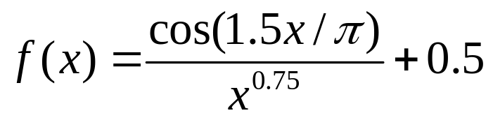
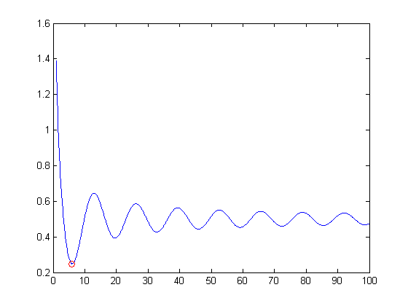
Over 25 runs, the GA found the global minimum 100% of the time.
Zone for which fminsearch
will fail

Slide 14
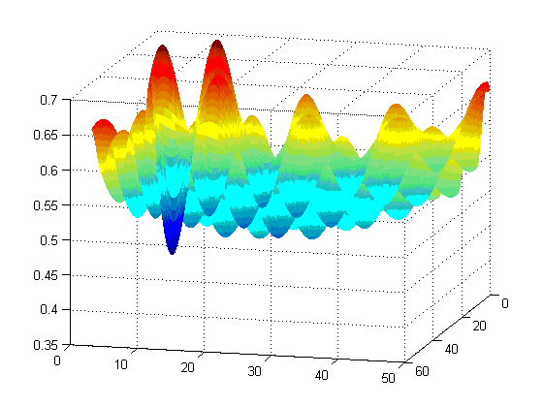
3D version of :
(2.98, 2.97)
Over 25 runs, the GA found the global minimum 100% of the time.

Slide 15
The Task here is function minimization
We can represent decimal real numbers as a vector of 1’s and 0’s using dec2binvec. Note the LEFTMOST bits are the low-order bits! We convert binary vectors back to decimals with binvec2dec.
Here is the function to optimize
over the range [0,100]:
X(X<0) = 0;
X(X>100) = 100;
f = (1./(X.^0.75)).*cos(1.5*X/pi) + 0.5;
Here is the Matlab code

Slide 16
X = 6.07
Y = 2.49

Slide 17
Debugging stochastic code
How to rerun a stochastic function to give exactly the same run as the
previous one. Necessary for debugging stochastic code. Note: if you are
using rand and randn in the same function, beware! Go to the Web and
find and download randtx and randntx
function out = fname(var1, rerun)
if nargin == 2
seed_fid = fopen(‘seed.txt', 'r');
seed = fscanf(seed_fid, '%f');
else
seed = fix(1e6*sum(clock));
seed_fid = fopen('seed.txt', 'w');
fprintf(seed_fid, '%.0f', seed);
fclose(seed_fid);
end;
rand('state', seed);
% remainder of your program goes here…

